Slide 1

AUTONOMOUS COLOR PEN READER
Capstone Project | Fall 2018

Slide 2
1. INTRODUCTION
1
Our members, motivations, significance and existing technologies

Slide 3
Team members
MICHAEL MORDKOVICH (MISHA SYROV)
Project Manager/Software/Hardware Engineer
HAORAN WU (STEVEN WU)
Hardware/Software Engineer
KAIXIAN ZHU (ELLIS ZHU)
Software Engineer
OLUWADARASIMI ADENIYI (DARA ADENIYI)
Project Manager/Hardware Engineer/Researcher
Notes:
This domain has controls around safeguarding assets. Some of the controls that this domain deals with are around the inventory of assets, ownership of assets, acceptable use of assets, return of assets.
It suggests controls around maintaining an inventory of assets and whether that inventory is current and kept up to date.
Also, it suggests that all information assets must have a clearly defined owner who is aware of their responsibilities.
It suggests that there be an acceptable use policy in place and there is process in place by which all employees are made aware of such policies.

Slide 4


Motivation and significance
Dyslexia affects up to 17% of general population_{[1]};
Around 3.4 million of US citizens are blind_{[2]};
Current pen readers have color limitation and only work in optimal conditions_{[3]};
Notes:
This domain has controls around safeguarding assets. Some of the controls that this domain deals with are around the inventory of assets, ownership of assets, acceptable use of assets, return of assets.
It suggests controls around maintaining an inventory of assets and whether that inventory is current and kept up to date.
Also, it suggests that all information assets must have a clearly defined owner who is aware of their responsibilities.
It suggests that there be an acceptable use policy in place and there is process in place by which all employees are made aware of such policies.

Slide 5

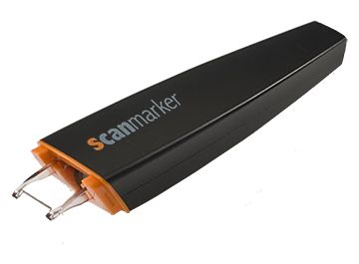
Existing technologies
Existing technologies such as Scan marker and C-Pen don’t read colored text on colored backgrounds well
Notes:
This domain has controls around safeguarding assets. Some of the controls that this domain deals with are around the inventory of assets, ownership of assets, acceptable use of assets, return of assets.
It suggests controls around maintaining an inventory of assets and whether that inventory is current and kept up to date.
Also, it suggests that all information assets must have a clearly defined owner who is aware of their responsibilities.
It suggests that there be an acceptable use policy in place and there is process in place by which all employees are made aware of such policies.

Slide 6
2. SOLUTION DEVELOPMENT
2
Solution proposal and plan of action

Slide 7
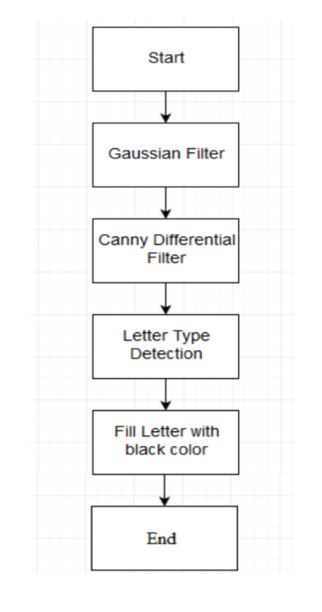
Plan of action
Color filtering diagram:
Notes:
This domain has controls around safeguarding assets. Some of the controls that this domain deals with are around the inventory of assets, ownership of assets, acceptable use of assets, return of assets.
It suggests controls around maintaining an inventory of assets and whether that inventory is current and kept up to date.
Also, it suggests that all information assets must have a clearly defined owner who is aware of their responsibilities.
It suggests that there be an acceptable use policy in place and there is process in place by which all employees are made aware of such policies.

Slide 8
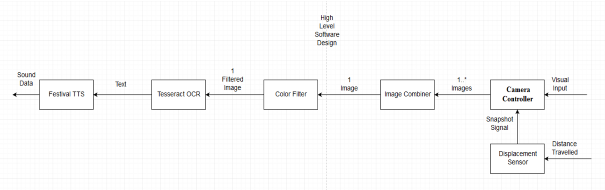
Plan of action
High-level Software Design:
Notes:
This domain has controls around safeguarding assets. Some of the controls that this domain deals with are around the inventory of assets, ownership of assets, acceptable use of assets, return of assets.
It suggests controls around maintaining an inventory of assets and whether that inventory is current and kept up to date.
Also, it suggests that all information assets must have a clearly defined owner who is aware of their responsibilities.
It suggests that there be an acceptable use policy in place and there is process in place by which all employees are made aware of such policies.

Slide 9
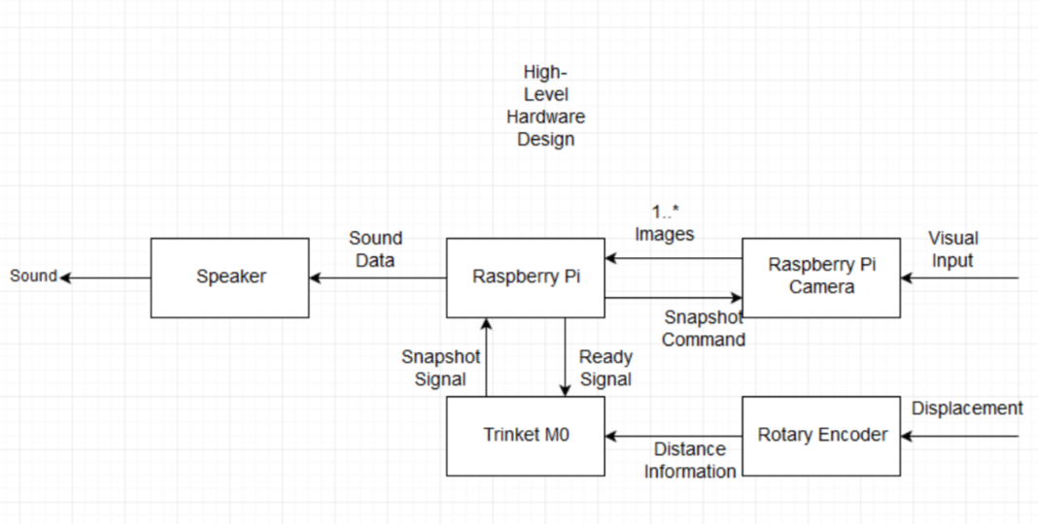
Plan of action
High-level Hardware Design:
Notes:
This domain has controls around safeguarding assets. Some of the controls that this domain deals with are around the inventory of assets, ownership of assets, acceptable use of assets, return of assets.
It suggests controls around maintaining an inventory of assets and whether that inventory is current and kept up to date.
Also, it suggests that all information assets must have a clearly defined owner who is aware of their responsibilities.
It suggests that there be an acceptable use policy in place and there is process in place by which all employees are made aware of such policies.

Slide 10
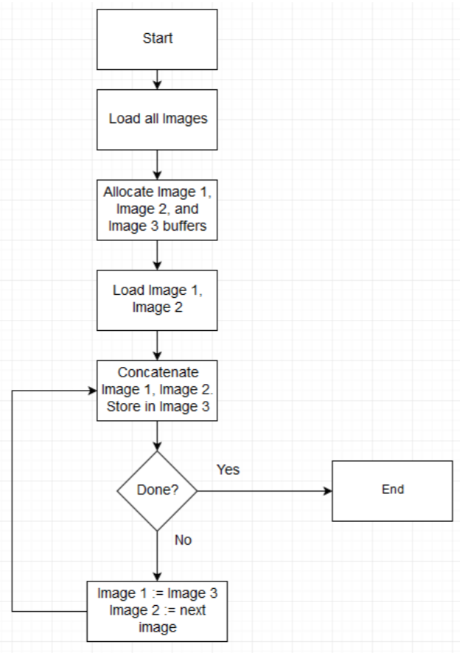
Plan of action
Image Combiner Design:
Notes:
This domain has controls around safeguarding assets. Some of the controls that this domain deals with are around the inventory of assets, ownership of assets, acceptable use of assets, return of assets.
It suggests controls around maintaining an inventory of assets and whether that inventory is current and kept up to date.
Also, it suggests that all information assets must have a clearly defined owner who is aware of their responsibilities.
It suggests that there be an acceptable use policy in place and there is process in place by which all employees are made aware of such policies.

Slide 11
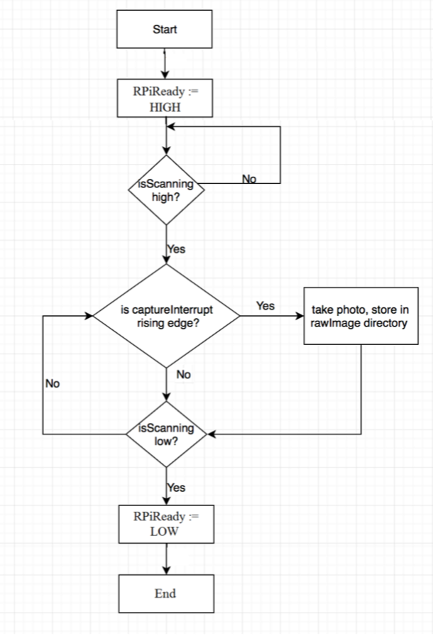
Plan of action
Camera Control Design:
Notes:
This domain has controls around safeguarding assets. Some of the controls that this domain deals with are around the inventory of assets, ownership of assets, acceptable use of assets, return of assets.
It suggests controls around maintaining an inventory of assets and whether that inventory is current and kept up to date.
Also, it suggests that all information assets must have a clearly defined owner who is aware of their responsibilities.
It suggests that there be an acceptable use policy in place and there is process in place by which all employees are made aware of such policies.

Slide 12
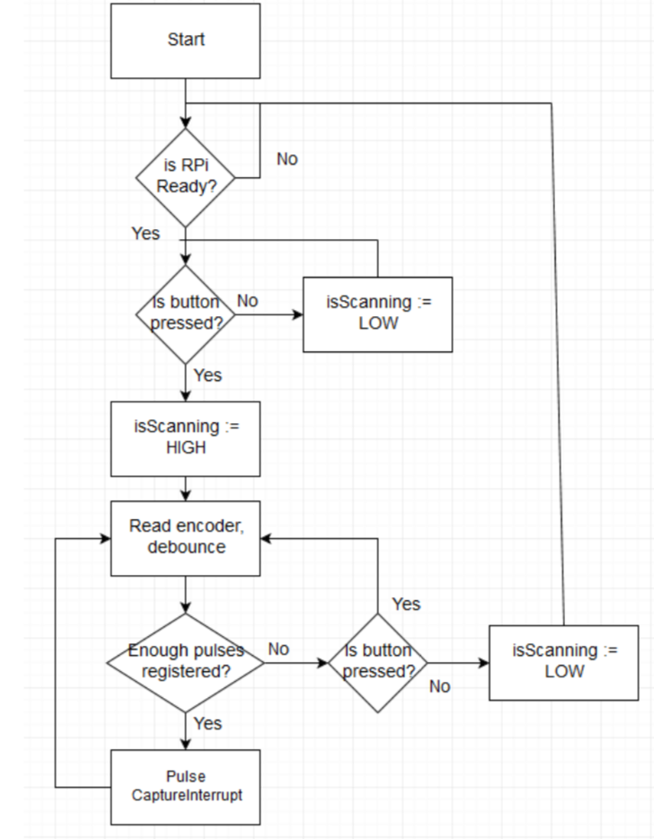
Plan of action
Closed-loop Feedback Design:
Notes:
This domain has controls around safeguarding assets. Some of the controls that this domain deals with are around the inventory of assets, ownership of assets, acceptable use of assets, return of assets.
It suggests controls around maintaining an inventory of assets and whether that inventory is current and kept up to date.
Also, it suggests that all information assets must have a clearly defined owner who is aware of their responsibilities.
It suggests that there be an acceptable use policy in place and there is process in place by which all employees are made aware of such policies.

Slide 13
Progress Made
Matlab simulations & choosing color filter design
Image Combiner algorithm
Rotatory Encoder design
Scanner design
Combined each component
Overcame hurdle by building pen instead of modifying
Notes:
This domain has controls around safeguarding assets. Some of the controls that this domain deals with are around the inventory of assets, ownership of assets, acceptable use of assets, return of assets.
It suggests controls around maintaining an inventory of assets and whether that inventory is current and kept up to date.
Also, it suggests that all information assets must have a clearly defined owner who is aware of their responsibilities.
It suggests that there be an acceptable use policy in place and there is process in place by which all employees are made aware of such policies.

Slide 14
Future Plan
Week 1: Finish all software required for camera control and feedback
Week 2: Design and assemble 3D enclosure for scanner
Week 3: Present Project at CREAT symposium, finish tweaks in feedback system
Week 4: Add battery, speaker, minor tweaking, fix bugs found during testing & present final prototype
Notes:
This domain has controls around safeguarding assets. Some of the controls that this domain deals with are around the inventory of assets, ownership of assets, acceptable use of assets, return of assets.
It suggests controls around maintaining an inventory of assets and whether that inventory is current and kept up to date.
Also, it suggests that all information assets must have a clearly defined owner who is aware of their responsibilities.
It suggests that there be an acceptable use policy in place and there is process in place by which all employees are made aware of such policies.

Slide 15
Commercialization
Features:
Our improved reading pen is more convenient and a time saver compared to using a dictionary.
There is no color limitation on characters you scan.
Action:
Plan and implement BTL marketing activities to ask for feedback
Problems in Commercialization:
How to carry out the business operations
How to maximize the market acceptance

Slide 16
Limitations and further development
OCR technology
Limitation in recognizing several parallel character lines.
We will try to restrict the scan area or improve the algorithm
Pen
The pen uses red light, so it can’t be used in colorful materials.
We will try to adapt the scanner to use white light, use filters or try a color-sensitive sensor
Recognition algorithm
The algorithm has low precision for hand-written characters.
We will try to combine several OCR algorithms to enhance precision
Scanning module
Small contrast between background and text may cause edge detector output to be faint making edge filling harder.
Combine different methods of edge detection.
Notes:
This domain has controls around safeguarding assets. Some of the controls that this domain deals with are around the inventory of assets, ownership of assets, acceptable use of assets, return of assets.
It suggests controls around maintaining an inventory of assets and whether that inventory is current and kept up to date.
Also, it suggests that all information assets must have a clearly defined owner who is aware of their responsibilities.
It suggests that there be an acceptable use policy in place and there is process in place by which all employees are made aware of such policies.

Slide 17
3. IMPACT
3
Ethical and societal impacts

Slide 18

Impact
Our reading pen can help people with dyslexia
Our reading pen can help people who are visually impaired
People who are not familiar with English can also use this pen to help them work.
People who have disabilities in arm or hands can also use our reading pen to control some robotic arms to do some normal action.
Notes:
This domain has controls around safeguarding assets. Some of the controls that this domain deals with are around the inventory of assets, ownership of assets, acceptable use of assets, return of assets.
It suggests controls around maintaining an inventory of assets and whether that inventory is current and kept up to date.
Also, it suggests that all information assets must have a clearly defined owner who is aware of their responsibilities.
It suggests that there be an acceptable use policy in place and there is process in place by which all employees are made aware of such policies.

Slide 19
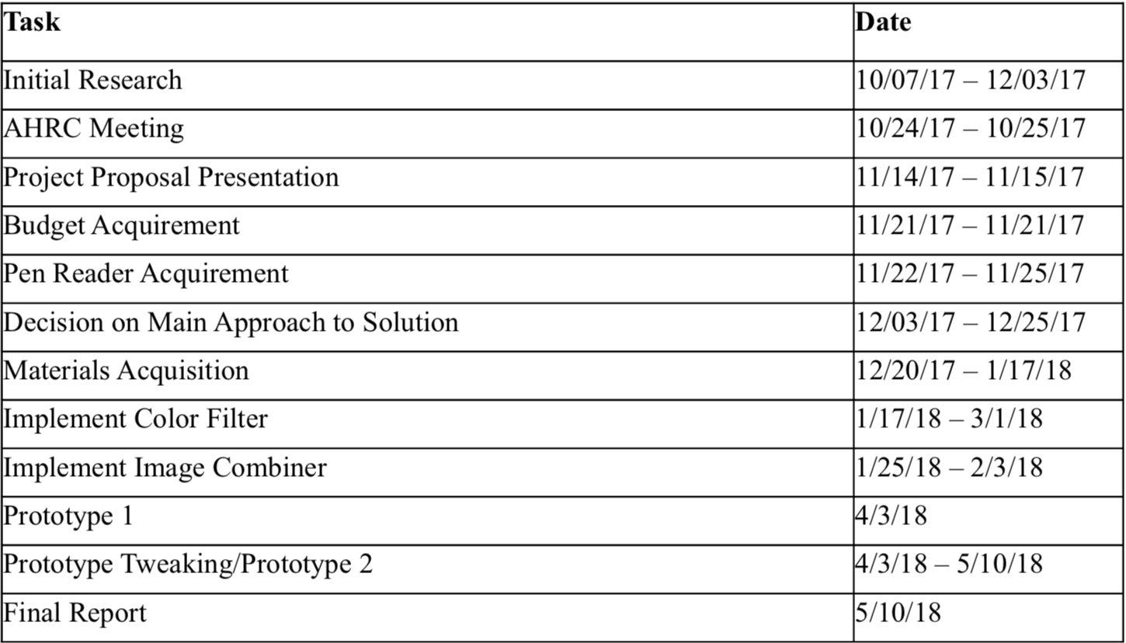
Timeline
Notes:
This domain has controls around safeguarding assets. Some of the controls that this domain deals with are around the inventory of assets, ownership of assets, acceptable use of assets, return of assets.
It suggests controls around maintaining an inventory of assets and whether that inventory is current and kept up to date.
Also, it suggests that all information assets must have a clearly defined owner who is aware of their responsibilities.
It suggests that there be an acceptable use policy in place and there is process in place by which all employees are made aware of such policies.

Slide 20
References
[1] Siegel, Linda S. “Perspectives on Dyslexia.”, Paediatrics & Child Health 11.9 (2006): 581–587. Print.
[2] Bailey R. N., Indian R. W., Zhang X., Geiss L. S., Duenas M.R., Saaddine J. B. “Visual impairment and eye care among older adults—five states,” MMWR 2006; 55(49):1321–1325.
[3] Eikvil, Line. "OCR-Optical Character Recognition.", 1993.
Notes:
This domain has controls around safeguarding assets. Some of the controls that this domain deals with are around the inventory of assets, ownership of assets, acceptable use of assets, return of assets.
It suggests controls around maintaining an inventory of assets and whether that inventory is current and kept up to date.
Also, it suggests that all information assets must have a clearly defined owner who is aware of their responsibilities.
It suggests that there be an acceptable use policy in place and there is process in place by which all employees are made aware of such policies.

Slide 21
Thank you.

